Slide 6
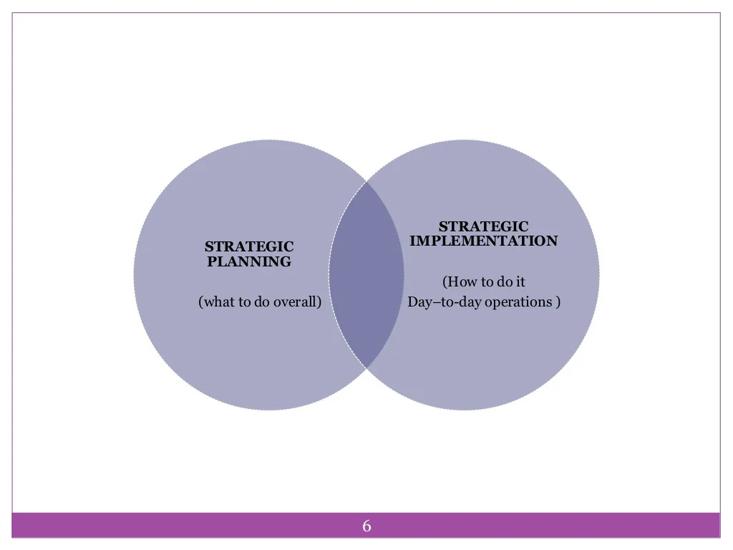

Slide 27
Reasons for Strategy Failure
1. Having a plan simply for plans sake. Some organizations go through the motions of developing a plan simply because common sense says every good organization must have a plan. Don’t do this. Just like most everything in life, you get out of a plan what you put in. If you’re going to take the time to do it, do it right.
2. Not understanding the environment or focusing on results. Planning teams must pay attention to changes in the business environment, set meaningful priorities, and understand the need to pursue results

Slide 28
Reasons for Strategy Failure
3. Partial commitment. Business owners/CEOs/presidents must be fully committed and fully understand how a strategic plan can improve their enterprise. Without this knowledge, it’s tough to stay committed to the process.
4. Not having the right people involved. Those charged with executing the plan should be involved from the onset. Those involved in creating the plan will be committed to seeing it through execution.

Slide 29
Reasons for Strategy Failure
5. Writing the plan and putting it on the shelf. This is as bad as not writing a plan at all. If a plan is to be an effective management tool, it must be used and reviewed continually. Unlike Twinkies or a fine vino, strategic plans don’t have a good shelf life.
6. Unwillingness or inability to change. Your company and your strategic plan must be nimble and able to adapt as market conditions change.

Slide 30
Reasons for Strategy Failure
7. Having the wrong people in leadership positions. Management must be willing to make the tough decisions to ensure the right individuals are in the right leadership positions. The “right” individuals include those who will advocate for and champion the strategic plan and keep the company on track.
8. Ignoring marketplace reality, facts, and assumptions. Don’t bury your head in the sand when it comes to marketplace realities, and don’t discount potential problems because they have not had an immediate impact on your business yet. Plan in advance and you’ll be ready when the tide comes in.

Slide 31
Reasons for Strategy Failure
9. No accountability or follow through. Be tough once the plan is developed and resources are committed and ensure there are consequences for not delivering on the strategy.
10. Unrealistic goals or lack of focus and resources. Strategic plans must be focused and include a manageable number of goals, objectives, and programs. Fewer and focused is better than numerous and nebulous. Also be prepared to assign adequate resources to accomplish those goals and objectives outlined in the plan.

Slide 32
Methods To Overcome Strategic Failure
Strengthen your support network
Surrounding yourself with friends, family and mentors that can be supportive during hard times can prevent feelings of isolation. You might feel alone in your job, but having people around to make you feel loved and essential outside of work can keep spirits high. These people can also be great outlets for advice or processing critical decisions.
Manage cash flow effectively
Without consistent cash flow, your business will eventually dry up and die. You need to have money coming in, or you won’t be able to pay expenses. First, have a cash flow forecast, so you know what money is coming in and out. Remember, this is only a forecast, but it will give you insight into your financial future. Use the estimates to project likely sales and expenditures, so you know how much you’re likely to have in your bank account.

Slide 33
Methods To Overcome Strategic Failure
Take responsibility for your actions
Take full responsibility for your thoughts, actions and reactions because you were involved, even if you were not the cause or source. It is so easy to blame everyone and anyone. Do not worry about anyone else; they must take responsibility themselves; you cannot force them. The biggest fear is being caught out or being found out. As soon as you say, ‘it was me’ ‘I did it’ ‘I am responsible’ no one can ever accuse you of it.
Improve through feedback
Creating feedback loops that help individuals and the organization internalize knowledge is the critical next step. As leaders of change, this is when you know you’ve reached the finish line. It’s not when you throw a strategy over the wall, but when the strategy defines how you work every day. When that happens, you can start the next curve, begin looking into the future, and think about how to improve things from there.

Slide 34
Methods To Overcome Strategic Failure
Take a step-by-step approach
The final strategy for overcoming your fear of failure is to start small, achieve positive results, and build on that momentum. You may have the expression “go big or go home”. Many people have used this expression to justify taking massive action or taking no action at all.
In some scenarios, this is a wise approach, but for many startup entrepreneurs, it is better to begin with smaller goals. Goals such as setting up your website, launching a crowd funding campaign, or acquiring your first customer, and then gradually building on those successes.

